Slide 1
Indus Valley Civilization
2500 B.C.E.
Akshat Rawat(RA1911030010088)
Yukta Goel(RA1911030010089)
Rahul Goel(RA1911030010094)
Devadarshan Sardar(RA1911030010116)
Rushil Saxena(RA1911030010119)
Sidhant Chourasiya(RA1911030010120)
Reeti Jha(RA1911030010121)

Slide 2
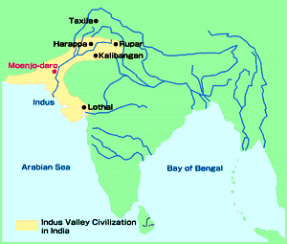
Roots of Indus Valley Civilization
Earliest civilizations in Indus Valley was discovered in 1856 by a railroad crew.
Harappa
Mohenjo-Dara or “Hill of the Dead”
Both cities shared urban design and architectural features.
3 miles in circumference with populations of 40,000

Slide 3
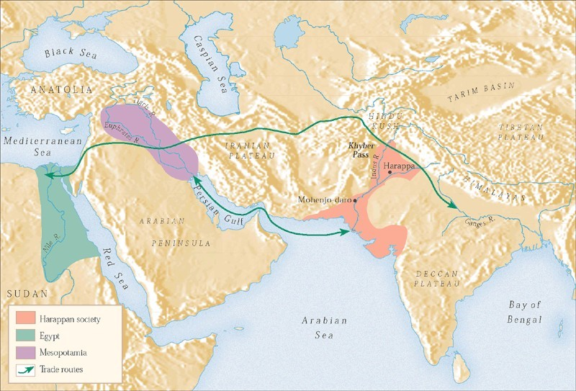
Page: 92

Slide 4
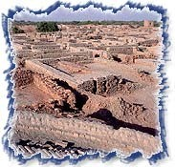
Roots of Indus Valley Civilization
Roots of Indus Valley began as early as 7000 B.C.E.
Possibly began as herders who moved into the river valley during colder months.
Over time, they may have decided to farm – river- watered lands of the valley.
They began trading by boat along the Indus down into the Arabian Sea, into the Persian Gulf, and up the Tigris and Euphrates into Mesopotamia.

Slide 5
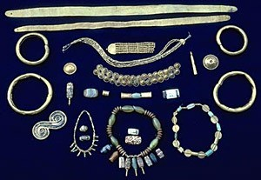
The Artifacts: Crafts and the Arts
Crafts of the Indus valley included pottery making, dyeing, metal working in bronze, and bead making.
Bead materials included:
jade from the Himalayas,
lapis lazuli from Afghanistan,
turquoise from Persia,
amethyst from Mewar in India,
and steatite, which was found locally.

Slide 6
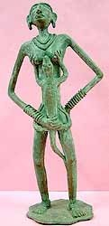
The Artifacts: Crafts and the Arts
Small sculptures in stone, terra cotta, and bronze appear to represent priestly or governmental officials, dancing girls, and perhaps mother goddesses.
Since there are no surviving texts to explain identities, these can only be guesses.

Slide 7
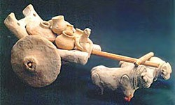
The Artifacts: Crafts and the Arts
Dice and small sculptures of bullock carts were probably used as toys and games.
The first known use of cotton as a fiber for weaving textiles occurred in the Indus Valley.

Slide 8
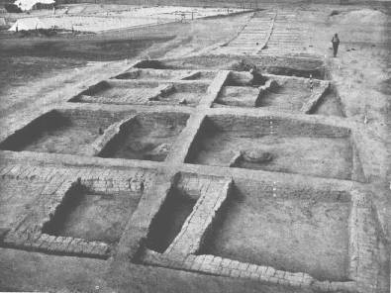
Carefully Planned Cities
Originating around 2500 B.C.E. the
thriving civilizations survived for around 500 years.
Both Harappa and Mohenjo-Daro, two of the largest among 500 sites, were three miles in circumference with around 40,000 people.

Slide 9
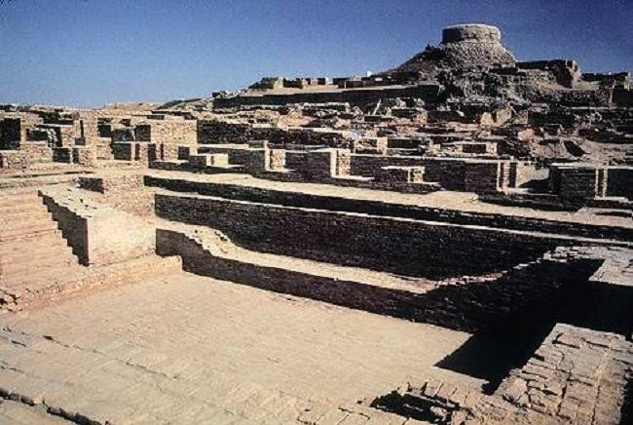
Mohenjo-Daro and Harappa
To the north is a citadel or raised area.
In Mohenjo-Daro, the citadel is built on an architectural platform about 45 feet above the plain.
On the summit was a huge communal bath.
Next to the large bath was a huge open space—a granary where food was stored from possible floods.
Fortified walls mark the southeast corner.

Slide 10
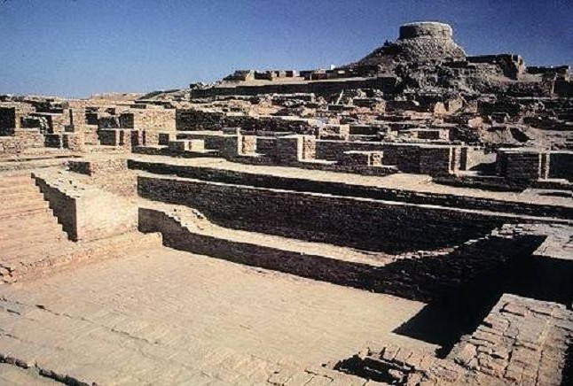

Slide 11
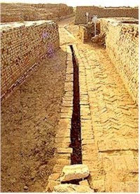
Mohenjo-Daro and Harappa
The lower city was laid out in a gridiron with the main streets about 45 feet wide.
Private houses, almost every one with its own well, bathing space, and toilet consisting of a brick seat over a drainage area.
Brick-lined drains flushed by water carried liquid and solid waste to sumps, where it was carted away, probably to fertilize nearby fields.

Slide 12
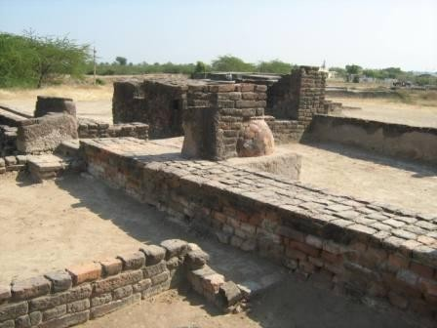
Mohenjo-Daro and Harappa
The town plan was regular.
Even fire-baked bricks were uniform in size and shape.
The regularity of plan and construction suggests a government with organization and bureaucratic capacity.
No monumental architecture clearly marks the presence of a palace or temple.
There is little sign of social stratification in the plan or buildings.

Slide 13
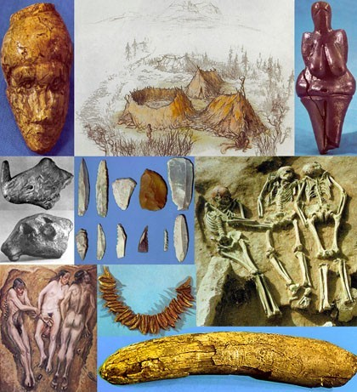
Indus Valley Burial Sites
Heads pointing to the north
Some grave goods, such as pots of food and water, small amounts of jewelry, simple mirrors, and some cosmetics.
Not extravagant like royal burials of Egypt or even of Mesopotamia.

Slide 14
Indus Valley Archaeological Finds
Among the 20,000 artifacts uncovered, the extraordinary extremes of wealth and poverty of Egypt and Mesopotamia do not appear.
Why do you think that is the case?

Slide 15
Indus Valley Archaeological Finds
Questions of Interpretation:
Artifacts stress the apparent classlessness of the society.
Until the Harappan language is deciphered, its civilization will remain mysterious.

Slide 16
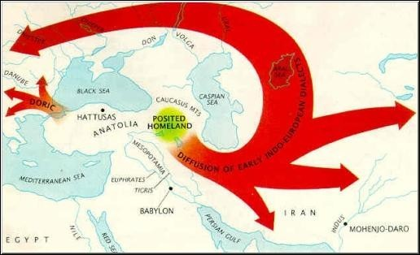
Enter: The Aryans
Approximately 1500 B.C.E. a nomadic and pastoral people who spoke the Indo-European language passed through the Hindu Kush mountains.
They called themselves “Aryans” or “noble people.”
They established small herding and agricultural communities throughout northern India.
Their migrations took place over several centuries.

Slide 17
Aryan Influence on Harappan Society
Aryan migrations took place over several centuries.
Their arrival was not an invasion or organized military campaign.
It is likely that Indo-European migrants clashed with Dravidians (people settled in the Harappan area.)
By the time Aryans entered India, internal problems had already brought Harappan society to the point of collapse.
During the centuries after 1500 B.C.E., Dravidian and Indo- European peoples intermarried and laid social and cultural foundations that influenced Indian society to present day.

Slide 18
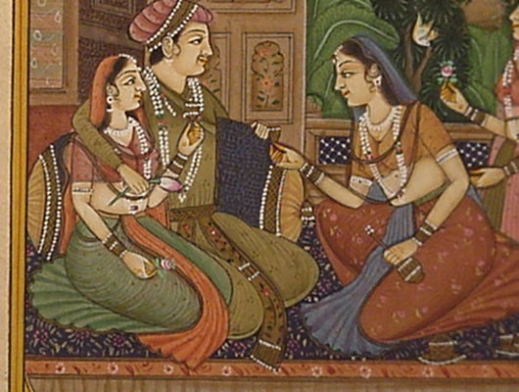
Aryan Influence on Harappan Society
The Aryans survived on pastoral economy, sheep and goats.
The especially prized their horses and cattle, but horses did not breed well in India so they had to import animals from Asia.
The Aryans consumed both dairy products and beef.
Centuries later cattle would become sacred.

Slide 19
Aryan Influence on Harappan Religion
The Vedas were collections of religious and literary poems and songs transmitted orally.
There were four parts.
The most important part was the Rig Veda, a collection of 1,028 hymns addressed to the Aryan gods.
Aryan priests compiled the Rig Veda between 1400 and 900 B.C.E.
It wasn’t put into writing until about 600 B.C.E.

Slide 20
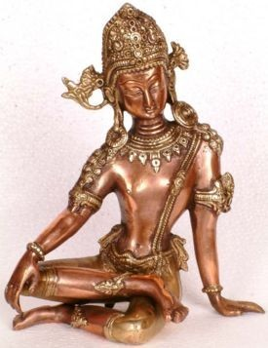
The Vedic Age 1500 to 500 B.C.E.
The Vedas refer often to conflicts between Aryans and the Dravidians and other people already living in India.
The Vedas refer to Indra, the Aryan war god and military hero, who would destroy parts of the city.
This suggests that the Aryans clashed repeatedly with the Dravidians of the Indus valley, attacking their cities and wrecking their irrigation systems.

Slide 21
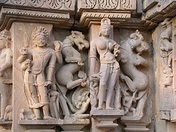
The Vedic Age 1500 to 500 B.C.E.
The Aryans often had friendly relations with Dravidian peoples.
They learned about the land and adopted Dravidian agricultural methods.
Still there was competitions over land and resources.
It appears that the Aryans did not have a formal government but they formed chiefdoms with a leader known as a raja (Sanskrit term for king.)

Slide 22
Aryan Migrations in India
Aryans first settled in the Punjab, the upper Indus River valley that straddles modern-day border between northern India and Pakistan.
They spread east and south and established communities throughout much of the subcontinent.
They learned to make iron tools and with axes and plow they cleared forests and established agricultural communities in the Ganges valley.
The Aryans gradually lost the tribal political organization they had brought into India and evolved into small kingdoms with formal governments.

Slide 23
The Caste System
Originally based on color: Aryans were “wheat-colored” and Dravidians were darker skinned.
Four Main Varnas or Castes:
Priests (brahmins)
Warriors and Aristocrats (Kshatriyas)
Cultivators, artisans, and merchants (vsaishyas)
Landless peasants and serfs ( shudras)
Untouchables (people who performed dirty tasks) added much later

Slide 24
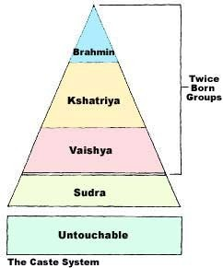
Jati (Subcastes)
As Vedic Society became more complex and specialized, the caste system changed to include specialized occupations.
Occupation determined an individuals jati (subcaste).
By the 18th and 19th centuries C.E., the system featured several thousand jati.
Brahmins alone have some 1,800 jati.

Slide 25
The Development of a Patriarch Society
Aryan Society had a strong patriarchal social order at the time of their migration into India.
All priests, warriors and tribal chiefs were men.
Women influenced affairs within their families but had no public authority.
Women rarely learned the Vedas and were denied formal education.
Sati, the practice of a wife sacrificing herself on her husband’s funeral pyre, was considered noble.

Slide 26
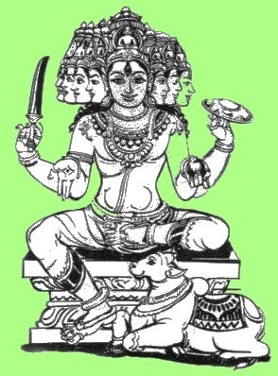
Religion in Vedic Age
The Rig Veda sheds light on religious practices.
The chief deity was Indra, a war god, who was partial to fighting and drink.
Varuna was a god who presided over the sky from his heavenly palace. He oversaw behavior of morals and preserved order.
Cattle, sheep, goats, and horses from Aryan herds were sacrificed to gain divine support, large families, long life, and abundant herds.

Slide 27
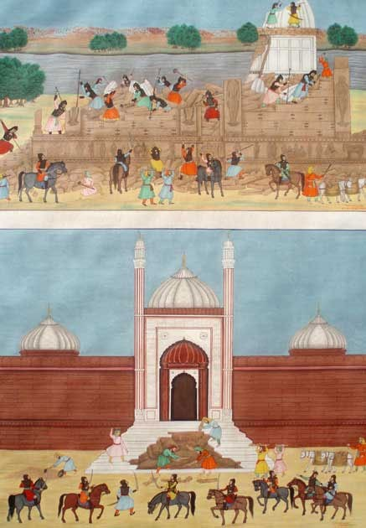
Religion in Vedic Age
Around 800 B.C.E. some individuals withdrew into the forest of the Ganges valley and lived as hermits.
They drew inspiration from religious beliefs of Dravidian people who worshipped nature spirits.
Dravidians also believed that human souls took on new physical forms after the deaths of their bodies.
The idea of reincarnation was born.

Slide 28

The Upanishads
Appeared late in Vedic Age, around 800 to 400 B.C.E.
Upanishad means “sitting in front of” and refers to practice of disciples gathering before a sage for discussion of religious issues.
The Upanishads were dialogues that explored the Vedas.

Slide 29
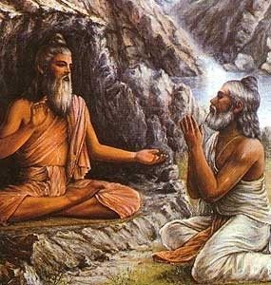
The Upanishads
Each person is part of a large, cosmic order and forms a small part of a universal soul known as Brahman.
Brahman is an eternal, unchanging foundation for all things.
Individual souls were born into physical world many times.
Their souls were most often humans but sometimes animals, and even occasionally plants.
The highest goal of the individual soul is to escape the cycle of birth and rebirth to enter into permanent union with Brahmin.

Slide 30
Doctrines of the Upanishads
Samsara – Upon death, individuals go temporarily to the World of the Fathers and then return to earth in a new form.
Karma – “…a man of good acts will become good, a man of bad acts, bad. He becomes pure by pure deeds, bad by bad deeds.”
Suffering – A certain amount of pain and suffering is inevitable in human existence.
Moksha is a deep endless sleep that comes with permanent liberation from physical incarnation.
Brahmin – You can achieve Brahmin through meditation and asceticism, leading extremely simple lives and denying all pleasure.

Slide 31
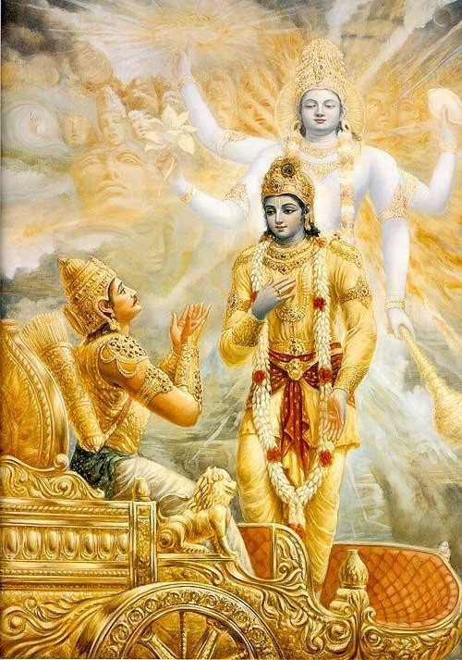
Religion and Vedic Age
Modern historians have often interpreted the Upanishads as a way to justify social inequalities imposed by the Caste System.
The doctrines of Samsara and karma have reinforced the Vedic social order.

Slide 32
Decline of Indus Valley Civilization
No solid evidence why the culture ended
Few believe it was due to natural disasters
Some say it was due to foreign invasions
Other believe it could have been a rebellious movement lead by the people of the lower cast searching for equality

